Slide 1

Hornet 7.0 Software Workshop #1

Slide 2



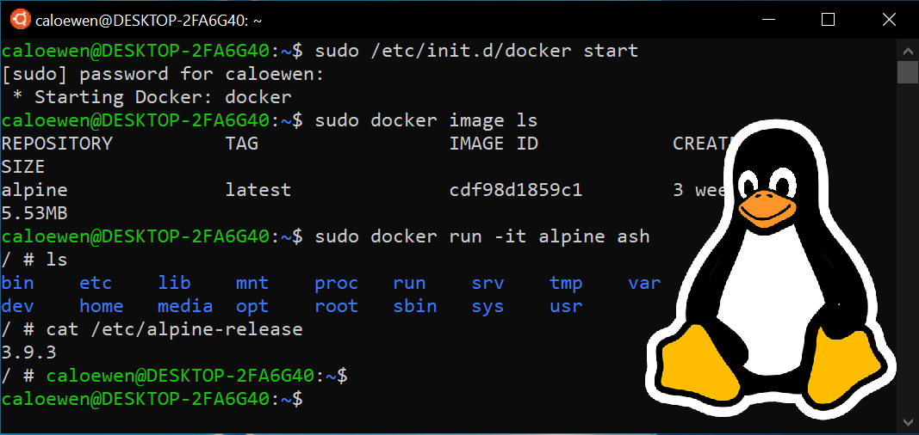
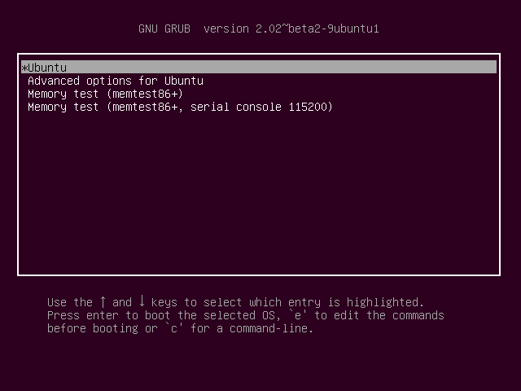
Setup (if you haven’t already done so)
1. Download Ubuntu 18.04
VM WSL2 Dual boot
2. Install ROS Melodic
http://wiki.ros.org/melodic/Installation/Ubuntu

Slide 3
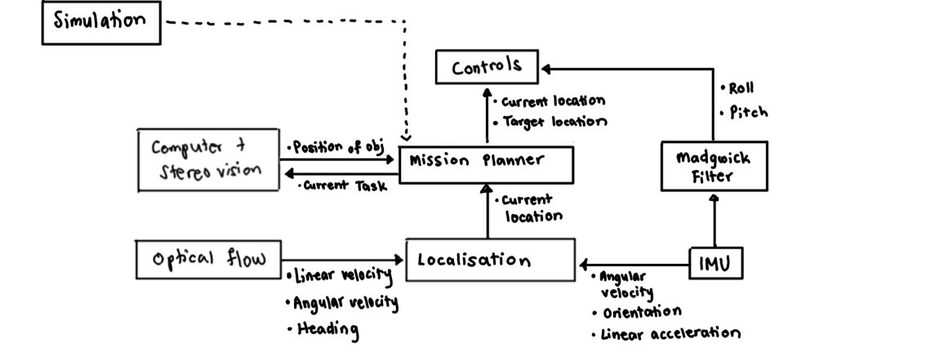

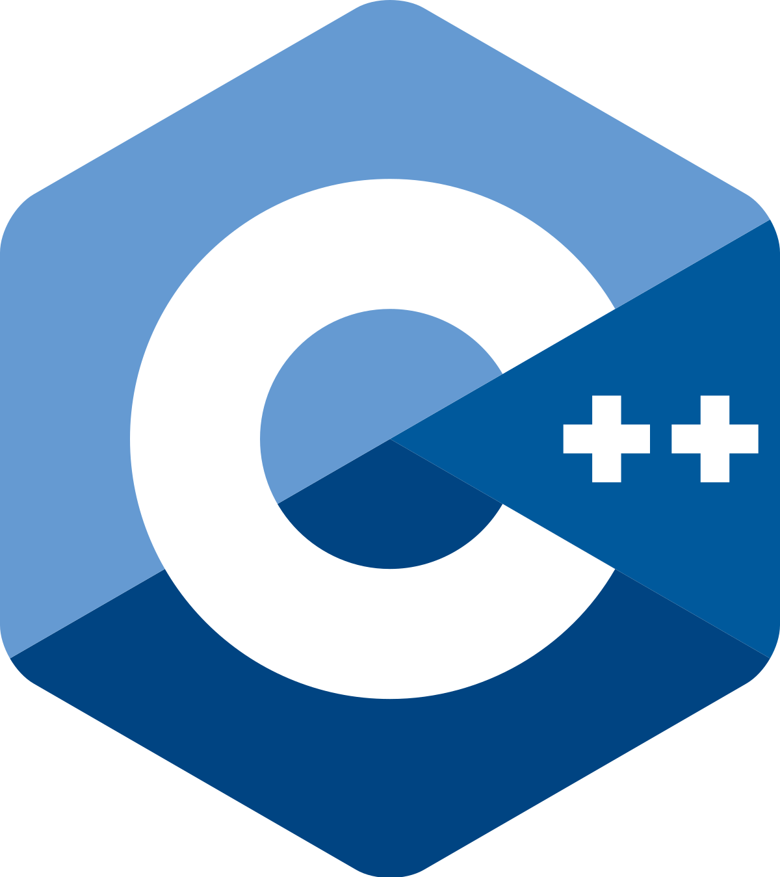

Hornet 5.0 Software Architecture

Slide 4



What is ROS?
Robot Operating System (ROS) is a robotics framework for writing robot software

Slide 5
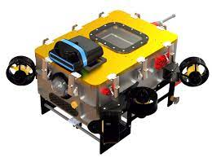
Why Do We Use ROS?
We want to do n number of things at the same time
Solutions:
Write concurrency code
Use ROS

Slide 6
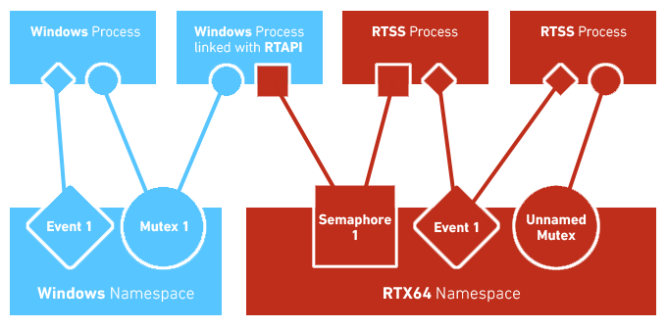
Inter-Process Communication (IPC)
An important part of ROS is its ability to act as an intermediary between multiple programs to allow them to communicate

Slide 7
Hornet 5.0 Software Architecture

Slide 8
roscore

Slide 9
Node
Node
Node
roscore

Slide 10
Message std_msgs/Header header
std_msgs/String author
std_msgs/String message
Topic
Publisher
Subscriber
/auv/imu
Messages
roscore

Slide 11
roscore

Slide 12
Time to build a ROS chat application!

Slide 13

ROS Workspace Folder Structure
catkin_ws
build
Files created while building packages
devel
Setup files (e.g. setup.bash)
logs
Log files
src
assignment1
assignment2
Packages
assignment3

Slide 14

ROS Package Folder Structure
assignment1
include
C++ include headers
msg
Custom messages
scripts
Python scripts
src
C++ scripts
CMakeLists.txt
CMake build file
package.xml
Provides meta information

Slide 15
Install catkin_tools
A tool to compile your code
$ sudo sh -c 'echo "deb http://packages.ros.org/ros/ubuntu `lsb_release -sc` main" > /etc/apt/sources.list.d/ros-latest.list'
$ wget http://packages.ros.org/ros.key -O - | sudo apt-key add -
$ sudo apt-get update
$ sudo apt-get install python-catkin-tools

Slide 16
Initialise your Workspace & Create your Package
$ mkdir catkin_ws
$ cd catkin_ws
$ mkdir src
$ catkin init
$ cd src
$ catkin create pkg assignment1
catkin_ws
src
assignment1
CMakeLists.txt
package.xml

Slide 17
Editing your package.xml
<?xml version="1.0"?>
<package format="2">
<name>assignment1</name>
<version>1.0.0</version>
<description>The assignment1 package</description>
<maintainer email="amadeus.winarto@u.nus.edu">Amadeus</maintainer>
<license>MIT</license>
<buildtool_depend>catkin</buildtool_depend>
</package>

Slide 18
Editing your package.xml
<?xml version="1.0"?>
<package format="2">
<name>assignment1</name>
<version>1.0.0</version>
<description>The assignment1 package</description>
<maintainer email="amadeus.winarto@u.nus.edu">Amadeus</maintainer>
<license>MIT</license>
<buildtool_depend>catkin</buildtool_depend>
</package>

Slide 19
Adding dependencies
...
<buildtool_depend>catkin</buildtool_depend>
...

Slide 20
Adding dependencies
...
<buildtool_depend>catkin</buildtool_depend>
<build_depend>message_generation</build_depend>
<build_depend>roscpp</build_depend>
<build_depend>rospy</build_depend>
<build_depend>std_msgs</build_depend>
<build_export_depend>roscpp</build_export_depend>
<build_export_depend>rospy</build_export_depend>
<build_export_depend>std_msgs</build_export_depend>
<exec_depend>roscpp</exec_depend>
<exec_depend>rospy</exec_depend>
<exec_depend>std_msgs</exec_depend>
...

Slide 21
Adding dependencies
...
<buildtool_depend>catkin</buildtool_depend>
<build_depend>message_generation</build_depend>
<depend>roscpp</depend>
<depend>rospy</depend>
<depend>std_msgs</depend>
...

Slide 22
Editing your package.xml
<?xml version="1.0"?>
<package format="2">
<name>assignment1</name>
<version>1.0.0</version>
<description>The assignment1 package</description>
<maintainer email="amadeus.winarto@u.nus.edu">Amadeus</maintainer>
<license>MIT</license>
<buildtool_depend>catkin</buildtool_depend>
<build_depend>message_generation</build_depend>
<depend>roscpp</depend>
<depend>rospy</depend>
<depend>std_msgs</depend>
</package>

Slide 23
Editing your CMakeLists.txt
...
find_package(catkin REQUIRED)
...

Slide 24
Editing your CMakeLists.txt
...
find_package(catkin REQUIRED COMPONENTS
message_generation
roscpp
rospy
std_msgs
)
...

Slide 25
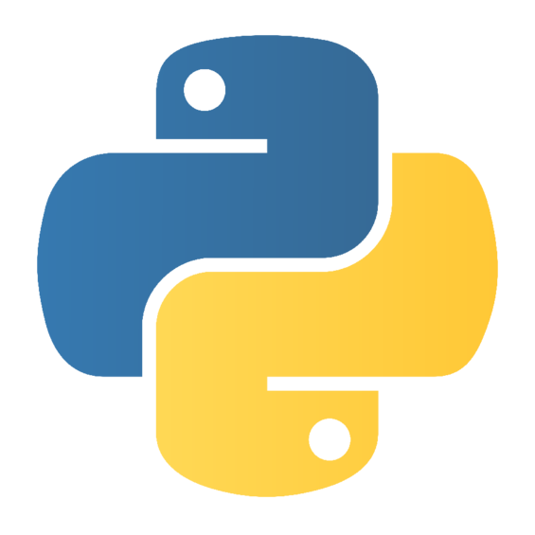
Create a Publisher
assignment1
scripts
talker.py
CMakeLists.txt
package.xml

Slide 26
Create a Publisher
talker.py
#!/usr/bin/env python
import rospy
from std_msgs.msg import String
def talker():
pub = rospy.Publisher('chatter', String, queue_size=10)
rospy.init_node('talker', anonymous=True)
rate = rospy.Rate(10)
while not rospy.is_shutdown():
hello_str = "hello world %s" % rospy.get_time()
rospy.loginfo(hello_str)
pub.publish(hello_str)
rate.sleep()
if __name__ == '__main__':
try:
talker()
except rospy.ROSInterruptException:
pass

Slide 27
Create a Publisher
$ roscore
$ rostopic echo chatter
$ cd catkin_ws
$ catkin build
$ source devel/setup.bash
$ chmod +x src/assignment1/scripts/talker.py
$ rosrun assignment1 talker.py

Slide 28
Custom Messages
assignment1
scripts
msg
std_msgs/Header header
std_msgs/String author
std_msgs/String message
Chat.msg
CMakeLists.txt
package.xml

Slide 29
Custom Messages
CMakeLists.txt
# add_message_files(
# FILES
# Message1.msg
# Message2.msg
# )
add_message_files(
FILES
Chat.msg
)
# generate_messages(
# DEPENDENCIES
# std_msgs
# )
generate_messages(
DEPENDENCIES
std_msgs
)

Slide 30
Custom Messages
talker.py
#!/usr/bin/env python
import rospy
from std_msgs.msg import Header, String
from assignment1.msg import Chat
def talker():
pub = rospy.Publisher('chatter', Chat, queue_size=10)
rospy.init_node('talker', anonymous=True)
rate = rospy.Rate(10)
while not rospy.is_shutdown():
hello_str = raw_input()
header = Header()
header.stamp = rospy.Time.now()
source_id = String(rospy.get_name())
message = String(hello_str)
c = Chat(header, source_id, message)
...

Slide 31
Custom Messages
talker.py
...
def talker():
pub = rospy.Publisher('chatter', Chat, queue_size=10)
rospy.init_node('talker', anonymous=True)
rate = rospy.Rate(10)
while not rospy.is_shutdown():
hello_str = raw_input()
header = Header()
header.stamp = rospy.Time.now()
author = String(rospy.get_name())
message = String(hello_str)
c = Chat(header, author, message)
pub.publish(c)
rate.sleep()
...

Slide 32
Custom Messages
talker.py
...
while not rospy.is_shutdown():
hello_str = raw_input()
header = Header()
header.stamp = rospy.Time.now()
author = String(rospy.get_name())
message = String(hello_str)
c = Chat(header, author, message)
pub.publish(c)
rate.sleep()
if __name__ == '__main__':
try:
talker()
except rospy.ROSInterruptException:
pass

Slide 33
Custom Messages
$ roscore
$ rostopic echo chatter
$ cd catkin_ws
$ catkin build
$ source devel/setup.bash
$ rosrun assignment1 talker.py

Slide 34
Assignment #1
Follow the following tutorials:
https://wiki.ros.org/ROS/Tutorials/UnderstandingTopics
https://wiki.ros.org/ROS/Tutorials/WritingPublisherSubscriber%28python%29
Learn how to write a subscriber
Combine a publisher and a subscriber into a chat system

Slide 35
Assignment #1 (Details)
Create a small decentralized chat program in C++ or Python using ROS as your middleware
The chat program has to have to ability to tell who the message is from, display it, and be able to send messages to other people as well
It is a group chat and NOT a 1-to-1 chat
Bonus Challenges:
Limit the chat history of your program to display only the latest 10 group messages
Differentiate different authors with different colours

